Slide 1
CinemaScope: Automated Sentiment Analysis of IMDb Movie Reviews for Strategic Entertainment Marketing
Team Members
Shakiba
Muhammad
Reihaneh
Jinendra
Hussain
April 16th, 2024
Notes:
Thao

Slide 2






Agenda:
Business Question
Data Pre-processing & Exploratory analysis
Algorithms, Analysis, and Implementations
Results and Evaluation
Conclusions
Group Member Contributions
Notes:
Charanya

Slide 3
Part-I
Recurrent Neural Network

Slide 4

Business Problem
Problem Statement:
The company seeks to automate the process of sentiment analysis on movie reviews. The goal is to develop a deep learning model that can accurately classify the sentiment of movie reviews as positive or negative. This will enable us to quickly gauge public opinion of new releases, identify shifts in viewer preferences, and adjust marketing strategies accordingly.
This Photo by Unknown Author is licensed under CC BY-SA

Slide 5
Data Overview
The IMDb movie reviews dataset consists of textual movie reviews and associated binary sentiment labels (positive or negative). The dataset is typically used for binary sentiment classification tasks.
Reviews (Text Data): Each entry is a movie review, which is a string of text. The length of these reviews varies significantly from one another.
Labels: Each review has a corresponding label:
0 for a negative review
1 for a positive review

Slide 6
Data Overview
The IMDb movie reviews dataset consists of textual movie reviews and associated binary sentiment labels (positive or negative). The dataset is typically used for binary sentiment classification tasks.
Reviews (Text Data): Each entry is a movie review, which is a string of text. The length of these reviews varies significantly from one another.
Labels: Each review has a corresponding label:
0 for a negative review
1 for a positive review

Slide 7
Data Preprocessing
Tokenizer Initialization
fit_on_texts
texts_to_sequences
pad_sequences
This class of keras allows to vectorize a text corpus, by turning each text into either a sequence of integers (each integer being the index of a token in a dictionary).
This method updates internal vocabulary based on a list of texts. In the case of Tokenizer, it creates a dictionary of word-to-index pairs.
Transforms each text in texts to a sequence of integers. Only words known by the tokenizer will be taken into account.
This function ensures that all sequences in a list have the same length by padding them with zeros at the end until they reach the maximum length (max_length). This is necessary because the models in TensorFlow require inputs to have consistent sizes.

Slide 8
RNN Model Architecture
Embedding Layer
LSTM Layers
Dense Output Layer
Converts input sequences of integers into fixed-size dense vectors. This captures not just the identity of words but also their semantic relationships, which are crucial for understanding textual context.
Consists of two LSTM layers; the first returns sequences to maintain temporal information across the text, while the second condenses this to a single output vector, summarizing the text's sentiment.
Uses a sigmoid activation to convert the LSTM’s output into a probability score indicating the likelihood of the review being positive.
Notes:
Thao

Slide 9
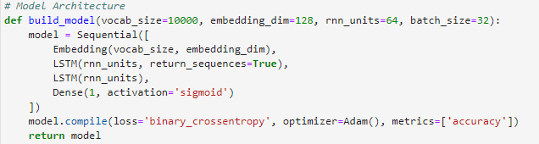
Model Compilation and Optimization
Loss Function: binary_crossentropy, ideal for binary classification, focusing on minimizing the error in probability estimation between predicted and actual sentiments.
Optimizer: adam, which adaptly adjusts learning rates, enhancing the efficiency and accuracy of model training.
Metric: accuracy, directly measures how often the model predicts correctly, straightforward for performance evaluation.
Notes:
Thao

Slide 10
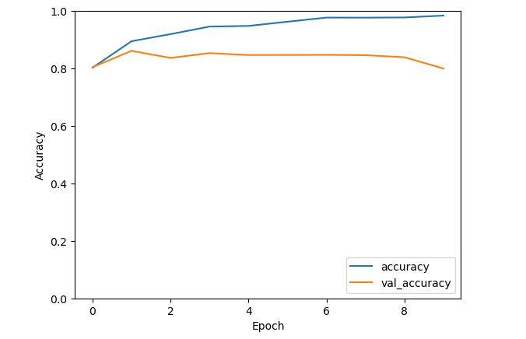
Results and Evaluation
Training Accuracy: 98.4%
Validation Accuracy on 5th Epoch: 84%
Test Accuracy: 83%

Slide 11
Part-II
Reinforcement learning

Slide 12
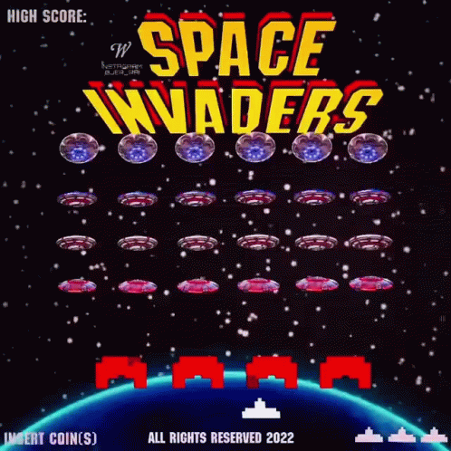
Strategic Gameplay in Space Invaders
Game Overview: Players control a spaceship at the bottom of the screen in 'Space Invaders'.
Primary Goal: Defend against an army of horizontally moving and descending aliens.
Objective: Eliminate all aliens before they reach the screen's bottom.
Player Actions: Maneuver the spaceship left or right; shoot projectiles upwards to destroy aliens.
Strategic Play: Skillful movement and timing are key to success in the game.

Slide 13
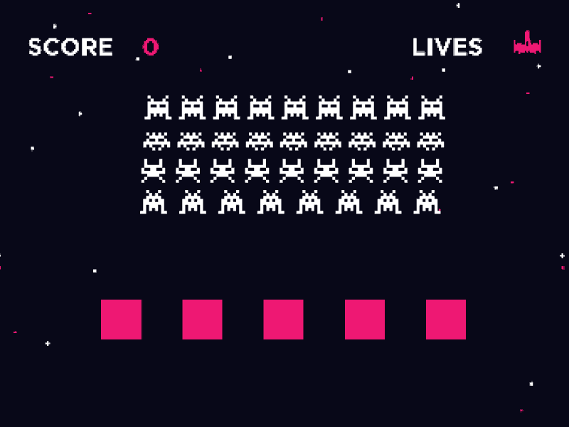
Gameplay Actions and States
Actions:
Move Left/Right
Fire projectile
Do Nothing
States:
Player State: Position of the spaceship.
Alien State: Positions and movement of aliens.
Projectile State: Position of projectiles fired.
Rewards and Penalties System
Rewards:
+10 points for each alien destroyed.
Penalties:
-50 points if an alien reaches the bottom.
-1 point for each projectile fired, to discourage spamming.

Slide 14
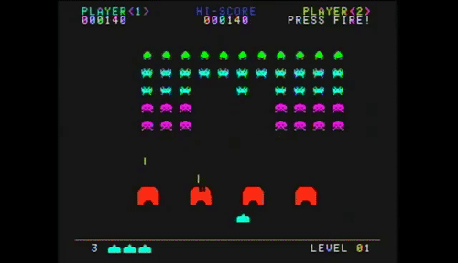
Network Architecture for Deep Learning
Deep Learning Strategy
Input Layer: State representation (player, aliens, projectiles).
Hidden Layers: Multiple layers with ReLU activation for processing game dynamics.
Output Layer: Softmax layer for action probability based on Q-values.
Deep Q-Network (DQN): Approximates optimal action-value function.
Experience Replay: Enhances learning stability by reusing past experiences.
Target Network: Provides stable targets for learning updates

Slide 15
Detailed Analysis Procedure
Iterative Learning and Evaluation
Deployment and Continuous Improvement
Simulate Gameplay
Train the Model
Epsilon-Greedy Policy: Balance exploration and exploitation.
Update Game State: Modify game state based on actions and dynamics.
Replay Buffer: Store transitions of states, rewards, and actions.
Network Training: Train on batches of experiences sampled from the buffer.
Target Q-Values: Estimate targets using target network and update primary network.
Performance Assessment: Evaluate based on average rewards and aliens destroyed.
Hyperparameter Tuning: Modify parameters based on observed learning behavior.
Model Deployment: Implement in live game environment.
Continuous Learning: Adapt to new gameplay experiences and evolving dynamics.

Slide 16
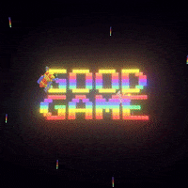
Final Reward
Conclusion
The final reward in "Space Invaders" combines positive rewards for destroying aliens with negative penalties for failing to defend or inefficiently using projectiles.
It encourages strategic resource management and action prioritization to maximize overall reward while minimizing penalties.
Reinforcement learning is a powerful technique for training AI models in strategic decision-making across various applications.
In "Space Invaders," it requires careful consideration of state and action representations, learning approaches, and continuous refinement.
This framework provides a structured approach for effectively training models to execute strategic moves in "Space Invaders," serving both educational and gaming purposes in the AI field.

Slide 17
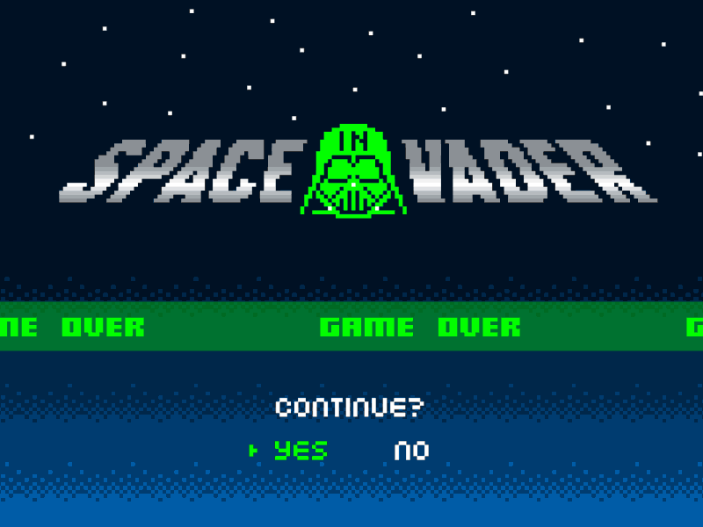
Questions ?

